Slide 1
Where Do We Go From Here?
Life After Regulatory Revisions

Slide 2
Some Challenges We Are Facing as Advisors
Income threatens to drop considerably from sales of MFs
Upfront cash flows to get restricted severely
Direct transactions are looming as a threat: large free platforms emerging
Lower ability to service clients
Business conflict against client exit from funds

Slide 3
Fall In Income is #1 Concern
Can we substitute in some ways?
Do more business with smaller AMCs
Gather more AUM overall: widen the pipe
Gather AUM via client referrals
But most important, is to evaluate an opportunity that is staring the face

Slide 4
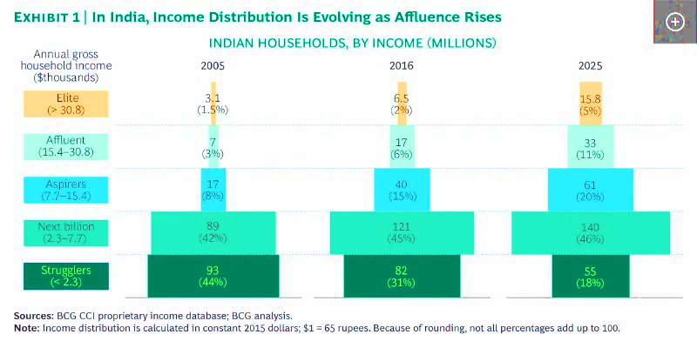
Surge In Incomes Is Coming!

Slide 5
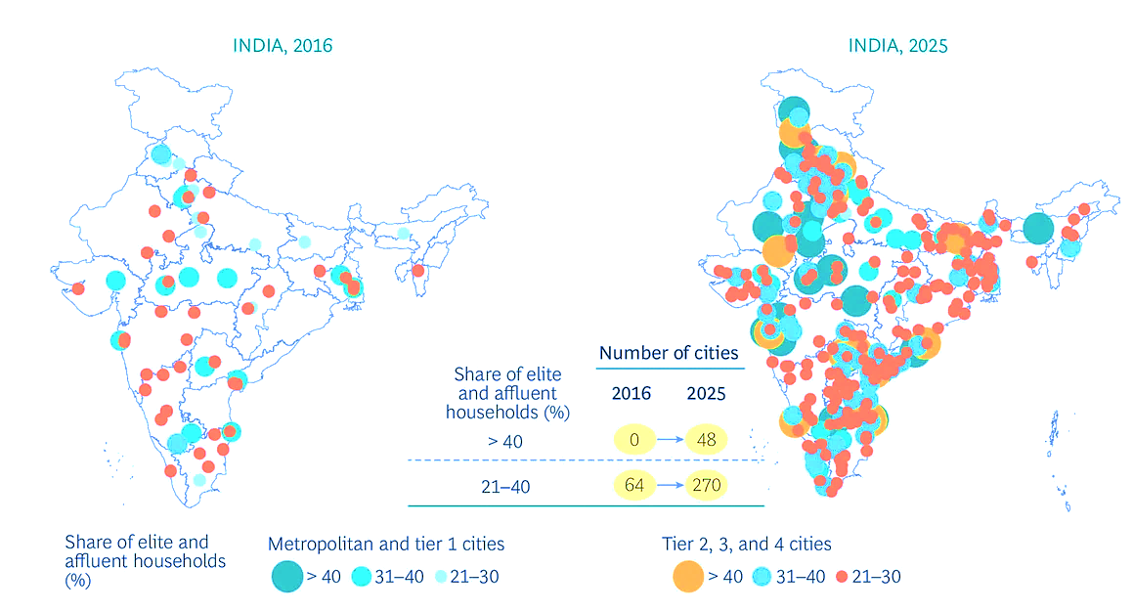
Affluence Will Be Widespread
Between 20-40% of Households in 270 Cities Will Have Income Above Rs. 1 lakh a month
Above 40% of the Households in 48 cities Will Have Income Above Rs. 2 lakhs a month

Slide 6
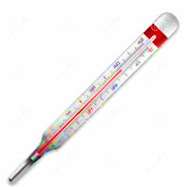
With Surge In Affluence …. There’s A Surge In Irrationality!
Life goals multiply rapidly
Money usage becomes impulse led
Family demands multiply
Investment priorities change every minute
Money Fever Becomes A Real Problem!!

Slide 7
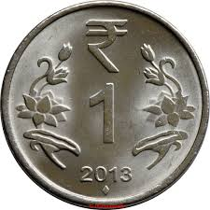
Can You Be The GP for Money Fevers?

Slide 8
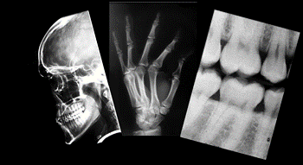
Diagnosis Reveals…
Investments go to real estate, gold on default mode
And many Ponzi schemes
Plus many durable purchases
Low mortgages, in fact prepayment rises
Paperwork in financial products looks frightening, so anything else that is quick looks good
Source: RBI Report on Household Finance

Slide 9
One Stop Prescription
Investments: FD, Equity, MFs, Bonds, IPOs,
Insurance: Life and Non-Life
Real Estate
Gold
Loans: Home, Education, Auto, Durables, Personal, SME
P2P Loans
Loan servicing and overall indebtedness
Estate planning

Slide 10
Why This Approach Has High Probability of Success?
Product manufacturers are sellers not advisors
Every seller claims to solve every problem (to a man with a hammer every problem looks like a nail!)
No clarity or comparability of risks, costs and fees of different investment opportunities

Slide 11
Alternative 2: You Be A Specialist How Do You Choose A Specialization?

Slide 12
Be A Customer Specialist…

Slide 13
There are Many Customer Types. And One Size Does Not Fit All!
Urban vs Non urban
Income earners vs non earners
Young vs Not young
Men vs women
Retired vs not retired
Independent vs with dependents
Pick your mix

Slide 14
You Need To Re-Imagine Your Business’ Relevance For Your Customer
Create research based advice framework
Create Deeper Access in Identifiable Segments
Invest in Your Business
Institutionalize Your Business

Slide 15
Regulatory Push Is Also To Institutionalize the Business….
What Are Your Alternatives / Opportunities?
Join a Well Established, Well Funded and Well Branded Network
Start A Network Together with Others
Invest in creating a Financial GP
Consolidate to Start A Segment Play / Niche Play

Slide 16
One Thing Is Sure
The journey from here on has to be planned on a different road.
The road we all took so far to get here has ended!

