Slide 1

How digital is transforming business
and service models?
Why embracing digital power is not
an option any more for your business?
What are the various digital initiatives
currently available for distributors?

Slide 2








Rise of digital India
Mobile Phones
Internet Access
2022(E)
@
1bn
Now
@
@
800+ mn
@
400 mn
Digital DNA is Changing
Set to grow beyond the 3Ms
MEN METRO MILLENNIALS
Men & Women
Young & Old
Urban & Rural
including vernacular users

Slide 3

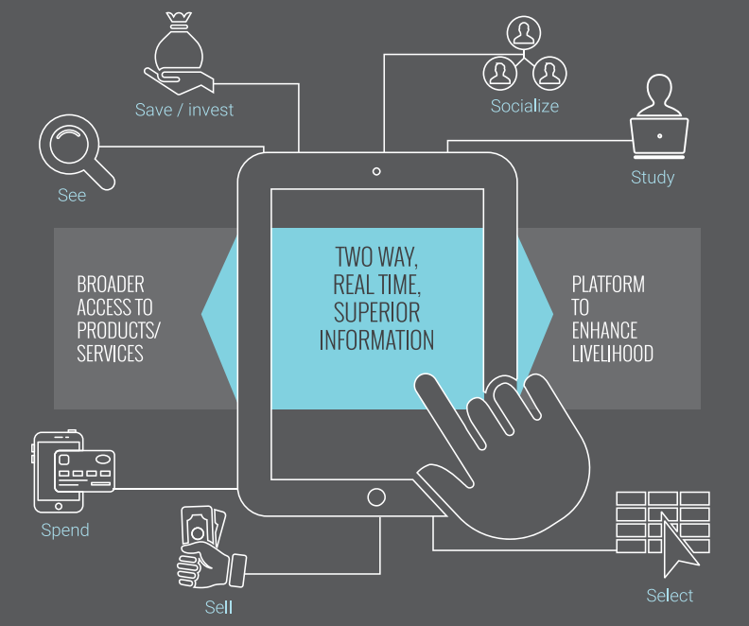
50
Digital is transforming everything we do
Explosion in the amount of information on the internet is
deeply influencing our purchase journey, service consumption & decision making

Slide 4








The digital mega-trend is playing out across EVERY sector
Financial Services
Manufacturing
Retail
Government
Birth and Death Registration
Tax Services
RTO Services
Registration Services
Transportation
Farming
Health Care
Education

Slide 5


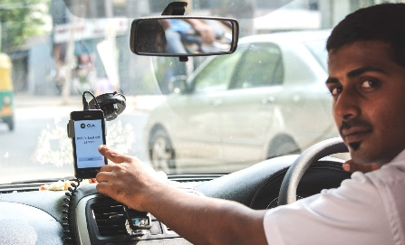
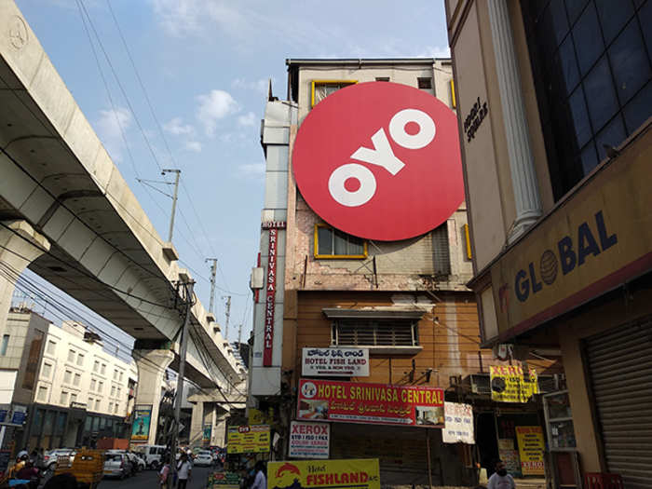


Partnering to start or stay in the game
Rural artisans or home bakers using their FB or Instagram accounts to promote their products
A taxi driver using a cab-hailing platform or a seller using any ecommerce platform
Small hotels, service apartment owners leapfrog their visibility via OYO
Digital platforms are empowering entrepreneurs with
access to market, marketing and finance using plug and play digital tools

Slide 6
Digital is helping enterprises and entrepreneurs completely reset and redefine service benchmarks
Service benchmarks
are set by other industries

Slide 7



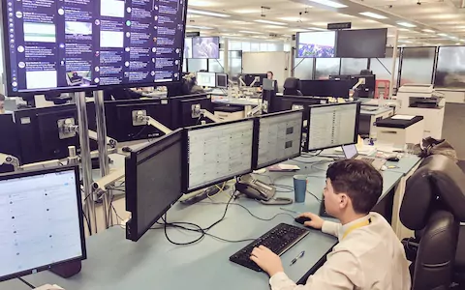
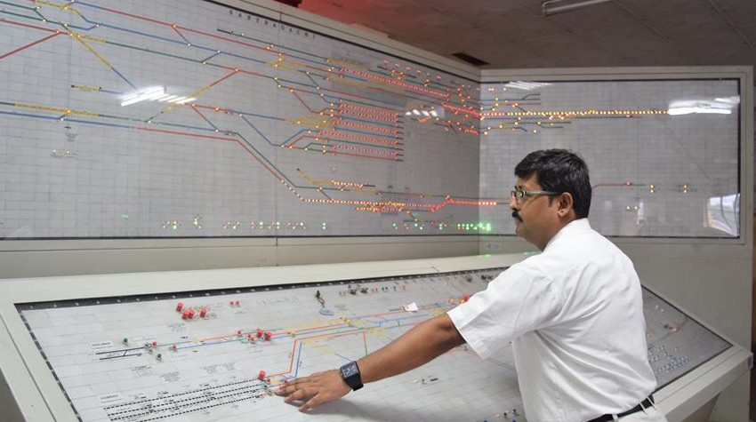
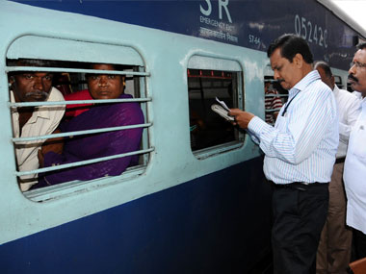

Mother is distressed as there is no milk in the Pantry
DRM Allahabad receives communication and nearest station is identified
Station master delivers milk to the distressed mother
Distressed Mother
11:03 AM
Ministry of Railways
Distressed Mother
@railminindia
11:08 AM
PNR 475231234, Coach-S1, seat no. 25. Train pantry has run out of milk and my infant is crying for milk. Please help!
@railminindia
PNR 475231234, Coach-S1, seat no. 25. Train pantry has run out of milk and my infant is crying for milk. Please help!
Delhi
Delhi
Pantry
Pantry
Varanasi
Varanasi
Varanasi
Delhi
Min. of Railways receives tweet at 11:08 AM
Nearest Station Identified
11:15 AM
Tweeted 11:03 AM
Milk Delivered
11:47 AM

Slide 8
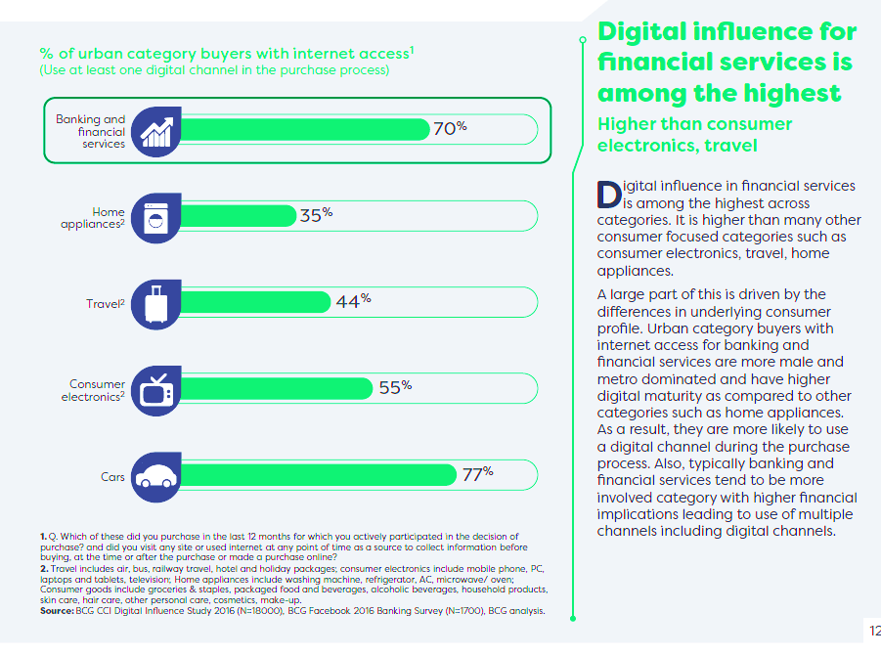
Digital Influence for financial products among the highest
Insurance – fast becoming end to end digital
evaluating options
signing up for a policy
service requests including claims processing
Agents able to focus more to grow their business
Private Banks in India are way ahead of many western counter parts
Bank customers are self-managing transactions digitally
Bank Branches are purely for deepening customer relationship
BCG report points to 70% of urban consumers already use digital in the purchase journey of financial products

Slide 9
Why does your business need digital power
42 Lakh
New investors
2018
60%
from
T30
10 Lakh
by
IFAs
Urban investors seeking digital services is a pronounced trend
60%
SIP
Need to service investors over the next 3-4 year period
Highest contribution
among all
distribution
sources
50%
<40yrs
With 50% of new investors being millennials, delivering a digitally powered service is the only way
77%
via
Paper
Not a scalable model
Cost implications
Limits your time to grow your business

Slide 10


Digital power from RTAs & AMCs
IFA business facets
Investor Life cycle management
Grow the business
Manage all the administrative activities
Coming
Soon!
Customer on-boarding using eKYC
CAMS Distributor Platform
  Investor onboarding with eKYC
  Seamless transaction initiation
  Generate investor statements
  Vast number of reports and insightful MIS
  Dashboards to monitor your business trends
  Revenue tracker
Digital transaction submission and statement
Mailback services provides a vast array of e-reports and MIS

Slide 11

The power of digital is shaping lives and businesses. This is the new reality
The new Indian is indelibly influenced by digital
Business and service models have to be digitally
re-tooled to win in this new reality

